Slide 1

AACSB: Assurance of Learning Workshop
Dr Anthony Devine - Newcastle Business School
Steven Baguley - Leicester Castle Business School
26th February 2020
BEYOND BUSINESS AS USUAL

Slide 2
State Learning
Goal
AoL Process
State Learning
Objective
Develop
Measurement
Evaluate
Improvements
Collect Pilot
Data
Collect
Data
Closing the
Loop
Analyze
Data
Implement
Improvements
Identify Needed
Improvements
BEYOND BUSINESS AS USUAL

Slide 3
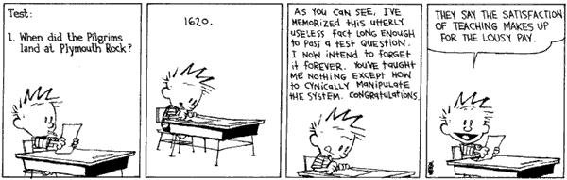
What is AoL?
Assessment is the systematic collection, review, and use of information about educational programs undertaken for the purpose of improving student learning and development. (Polomba & Banta, 1999).
Image courtesy of http://www.macroeducation.org
BEYOND BUSINESS AS USUAL

Slide 4
The AoL Process…
Defining goals and objectives (making our expectations explicit).
Aligning curricula with those goals.
Identifying instruments and measures to assess learning.
Collecting, analysing and disseminating assessment information.
Using assessment for continuous improvement, and documentation.
BEYOND BUSINESS AS USUAL

Slide 5
The Process Restated…
Another form of the previous steps can be stated as:
What will our students learn in our program? What are our expectations?
How will they learn it?
How will we know they have learned it or not?
What will we do if they have not learned it?
BEYOND BUSINESS AS USUAL

Slide 6
What do the standards really say about AoL?
Programme-level learning goals and objectives
Mission-driven
Direct measures for assessment
Indirect measures to complement the picture
Knowledge and skills
Use data for programme improvement
BEYOND BUSINESS AS USUAL

Slide 7
AoL - Terminology
Assurance of learning and outcome assessment.
Goals and objectives.
Direct and indirect measures.
Formative and summative assessment.
BEYOND BUSINESS AS USUAL

Slide 8
Key Terms: Direct vs. Indirect
Direct vs. Indirect measure:
  Direct measure: a measure based on students demonstrating their knowledge or skill.
  Indirect measure: a measure based on individuals, other than students, giving their opinions about the learning that occurs in the program.
BEYOND BUSINESS AS USUAL

Slide 9
Direct vs. Indirect Assessment
Direct assessment acquires evidence about student learning and the learning environment: Exams, projects, logs, portfolios, observations…
Indirect assessment acquires evidence about how students (or other stakeholders) feel about learning and their learning environment: Surveys, questionnaires, interviews, focus groups, reflective essays…
BEYOND BUSINESS AS USUAL

Slide 10
Our Focus (and AACSB’s)
Assessment of learning focuses on the results of a programme
Expert learning is a curriculum function.
It is not a course function.
BEYOND BUSINESS AS USUAL

Slide 11
Grading vs. Assessment
BEYOND BUSINESS AS USUAL

Slide 12
We Give Grades, Don’t We?
Aren’t grades
(by themselves)
Enough?
NO!
BEYOND BUSINESS AS USUAL

Slide 13
Aren’t I already doing that?
Why grades aren’t program assessment…
Exams 75
Presentation 85
Paper 90
Homework 80
Total 81
Exams 90
Presentation 84
Paper 60
Homework 82
Total 81
COURSE
Exams 50%
Oral Presentation 15%
Paper 25%
Homework 10%
BEYOND BUSINESS AS USUAL

Slide 14
Integrating AoL into your existing quality process
BEYOND BUSINESS AS USUAL

Slide 15
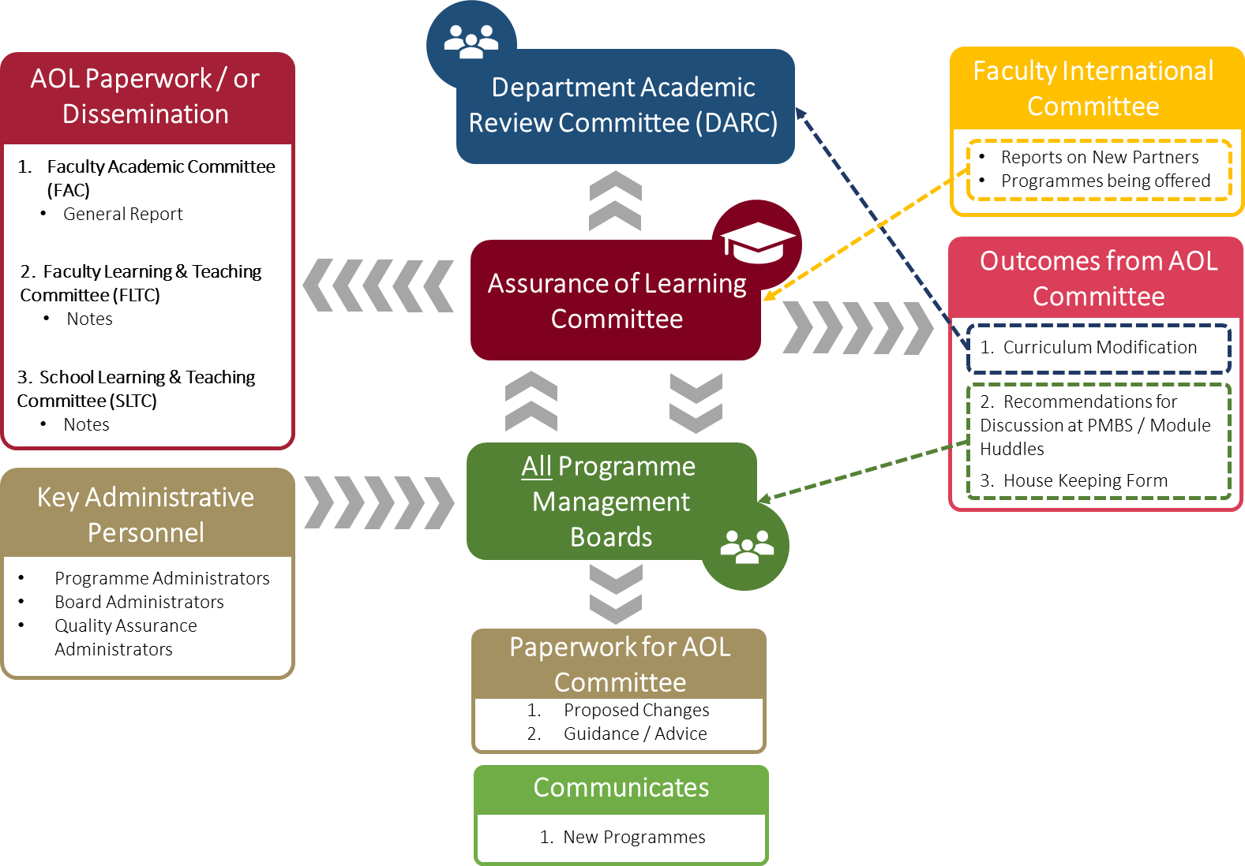
BEYOND BUSINESS AS USUAL

Slide 16
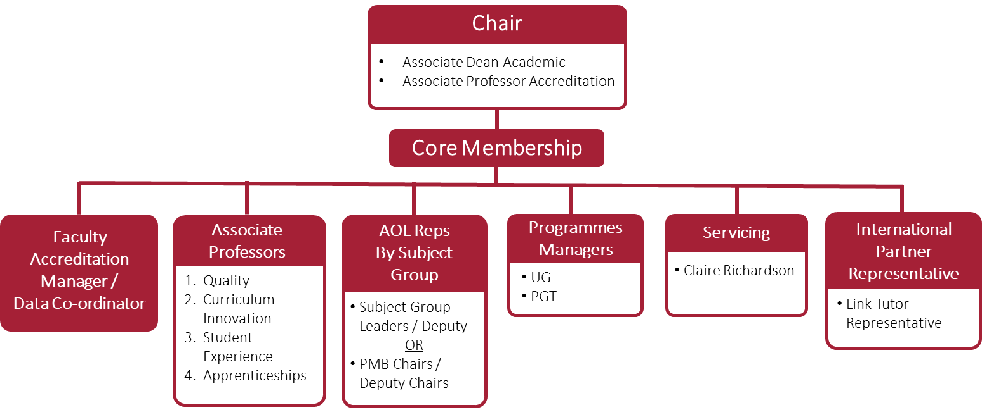
Proposed Structure of AoL Committee
BEYOND BUSINESS AS USUAL

Slide 17
BEYOND BUSINESS AS USUAL

Slide 18
BEYOND BUSINESS AS USUAL

Slide 19
Working with your data…
BEYOND BUSINESS AS USUAL

Slide 20
BEYOND BUSINESS AS USUAL

Slide 21
 |  |  | LCBS Learning Objectives
 |  |  | 1.1 | 1.2 | 2.1 | 2.2 | 2.3 | 3.2 (oral) | 3.3 (written) | 4.1 | 4.2
 | PL | Programme | Subject Specific Knowledge | Critique professional norms & practice | Open to and generate new ideas | Apply new ideas to existing concepts | Question/challenge/apply evidence-based analysis | Effective oral communication | Effective written communication | Awareness of the social and environmental responsibilities of business | Critically assess business models/pratices
N1N431 | Tom Webster | Accounting and Business Management | NOT MEASURED 18/19 | NOT MEASURED 18/19 | NOT MEASURED 18/19 | NOT MEASURED 18/19 | NOT MEASURED 18/19 | NOT MEASURED 18/19 | NOT MEASURED 18/19 | NOT MEASURED 18/19 | NOT MEASURED 18/19
N1N333 | Sudarshan Pillalamarri | International Finance and Business (level 6 top up) | 89% | 89% | NOT MEASURED 18/19 | NOT MEASURED 18/19 | NOT MEASURED 18/19 | NOT MEASURED 18/19 | NOT MEASURED 18/19 | 87% | 84%
N1N331 | Ali Gerged | Business Management and Finance | 100% | 92% | 85% | 85% | 92% | NOT MEASURED 18/19 | 100% | NOT MEASURED 18/19 | 85%
N10047 | Cam Calderon (Daly) or Bobb Webber (Erasmus) | (Business Studies - Daly) | NOT MEASURED 18/19 | NOT MEASURED 18/19 | NOT MEASURED 18/19 | NOT MEASURED 18/19 | NOT MEASURED 18/19 | 57% | 86% | NOT MEASURED 18/19 | NOT MEASURED 18/19
N10048 | Kathrine Lassen | Business Admin (Niels Brock) | 94% | 88% | 83% | 88% | 85% | 66% | 80% | 79% | 94%
N10011 | Louise Obara | Business and Management | 77% | 54% | 95% | 85% | 80% | 45% | 66% | NOT MEASURED 18/19 | NOT MEASURED 18/19
N1N232 | Andrew Nicholson - BAL | Business Ent and Inov | 100% | 70% | 80% | 80% | 70% | 100% | 33% | 89% | NOT MEASURED 18/20
N1L131 | Robert Webber | Business Management and Economics | 100% | 29% | 100% | 100% | 100% | 71% | 86% | NOT MEASURED 18/19 | NOT MEASURED 18/19
N12042 | Suman Saha | Int Business | 100% | 100% | 100% | 100% | 67% | 60% | 100% | NOT MEASURED 18/19 | NOT MEASURED 18/19
N3N441 | Lisa Wakefield | Accounting and Finance | NOT MEASURED 18/19 | NOT MEASURED 18/19 | NOT MEASURED 18/19 | NOT MEASURED 18/19 | NOT MEASURED 18/19 | NOT MEASURED 18/19 | NOT MEASURED 18/19 | NOT MEASURED 18/19 | NOT MEASURED 18/19
N56041 | Rachael Mabe | Advertising and Marketing Communications | 98% | 59% | 68% | 74% | 44% | 83% | 73% | 78% | 83%
N20044 | Simon Hill | Business Administration and Management (SCOPE)* Not using Bb 18/19 | NOT MEASURED 18/19 | NOT MEASURED 18/20 | NOT MEASURED 18/21 | NOT MEASURED 18/22 | NOT MEASURED 18/23 | NOT MEASURED 18/25 | NOT MEASURED 18/26 | NOT MEASURED 18/27 | NOT MEASURED 18/28
N12041 | Alistair Jones | Business and Globalisation | NOT MEASURED 18/19 | NOT MEASURED 18/19 | NOT MEASURED 18/19 | NOT MEASURED 18/19 | NOT MEASURED 18/19 | NOT MEASURED 18/19 | NOT MEASURED 18/19 | NOT MEASURED 18/19 | NOT MEASURED 18/19
N1N541 | Nurdilek Dalziel | Business And Marketing | 97% | 94% | INSUFFICIENT SAMPLE | INSUFFICIENT SAMPLE | INSUFFICIENT SAMPLE | 74% | 74% | NOT MEASURED 18/19 | 68%
N1N631 | Robert Webber | Business Management and Human Resource Management | 100% | 100% | 88% | 88% | 94% | 87% | 94% | INSUFFICIENT SAMPLE | 100%
L10041 | Cam Calderon | Economics | NOT MEASURED 18/19 | NOT MEASURED 18/19 | NOT MEASURED 18/19 | NOT MEASURED 18/19 | NOT MEASURED 18/19 | NOT MEASURED 18/19 | NOT MEASURED 18/19 | NOT MEASURED 18/19 | NOT MEASURED 18/19
L1N331 | Godwin Okafor | Economics and Finance | NOT MEASURED 18/19 | NOT MEASURED 18/19 | NOT MEASURED 18/19 | NOT MEASURED 18/19 | NOT MEASURED 18/19 | NOT MEASURED 18/19 | NOT MEASURED 18/19 | NOT MEASURED 18/19 | NOT MEASURED 18/19
L1L232 | Godwin Okafor | Economics and Politics | NOT MEASURED 18/19 | NOT MEASURED 18/19 | NOT MEASURED 18/19 | NOT MEASURED 18/19 | NOT MEASURED 18/19 | NOT MEASURED 18/19 | NOT MEASURED 18/19 | NOT MEASURED 18/19 | NOT MEASURED 18/19
N30042 | Linh Nguyen | Global Finance | INSUFFICIENT SAMPLE | INSUFFICIENT SAMPLE | INSUFFICIENT SAMPLE | INSUFFICIENT SAMPLE | INSUFFICIENT SAMPLE | INSUFFICIENT SAMPLE | INSUFFICIENT SAMPLE | INSUFFICIENT SAMPLE | INSUFFICIENT SAMPLE
N60041 | Never Muskwe | Human Resource Management | 82% | 82% | 82% | 91% | 91% | 93% | 82% | INSUFFICIENT SAMPLE | 100%
N55041 | Mark Ojeme | International Marketing and Business | 89% | 89% | 78% | 89% | NOT MEASURED 18/19 | 84% | 79% | 78% | 68%
N50041 | Nicola Thomas | Marketing | 100% | 83% | NOT MEASURED 18/20 | NOT MEASURED 18/20 | NOT MEASURED 18/20 | 82% | 94% | 89% | 78%
N20052 | Simon Hill | Business Administration and Management (SISFU)* ran as BA Adminstration L6 top up for 18/19 | NOT MEASURED 18/18 | NOT MEASURED 18/19 | NOT MEASURED 18/20 | NOT MEASURED 18/21 | NOT MEASURED 18/22 | NOT MEASURED 18/24 | NOT MEASURED 18/25 | NOT MEASURED 18/26 | NOT MEASURED 18/27
?? | ?? | CMDA / Business Management | NOT MEASURED 18/19 | NOT MEASURED 18/19 | NOT MEASURED 18/19 | NOT MEASURED 18/19 | NOT MEASURED 18/19 | NOT MEASURED 18/19 | NOT MEASURED 18/19 | NOT MEASURED 18/19 | NOT MEASURED 18/19
BEYOND BUSINESS AS USUAL

Slide 22
 |  |  | Learning Objectives
 |  |  | 1.1 | 1.2 | 2.1 | 2.2 | 2.3 | 3.2 (oral) | 3.3 (written) | 4.1 | 4.2
 | PL | Programme | Subject Specific Knowledge | Critique professional norms & practice | Open to and generate new ideas | Apply new ideas to existing concepts | Question/challenge/apply evidence-based analysis | Effective oral communication | Effective written communication | Awareness of the social and environmental responsibilities of business | Critically assess business models/pratices
N1N431 | Tom Webster | Accounting and Business Management
N1N333 | Sudarshan Pillalamarri | International Finance and Business (level 6 top up) | ACFI3424 (Essay) 12.03.2020 / J Margerison | ACFI3424 (Essay) 12.03.2020 / J Margerison |  |  |  |  |  | ACFI3424 (Exam) 05.2020 / J Margerison | ACFI3424 (Exam) 05.2020 / J Margerison
N1N331 | Ali Gerged | Business Management and Finance | CORP3400 (Diss) 04.2020 - W Emambocus | CORP3400 (Diss) 04.2020 - W Emambocus | CORP3400 (Diss) 04.2020 - W Emambocus | CORP3400 (Diss) 04.2020 - W Emambocus | CORP3400 (Diss) 04.2020 - W Emambocus | CORP3501 (Podcast) 12.11.19 / N Mwila | CORP3400 (Diss) 04.2020 - W Emambocus | CORP3400 (Diss) 04.2020 - W Emambocus | CORP3400 (Diss) 04.2020 - W Emambocus
N10047 | Cam Calderon (Daly) or Bobb Webber (Erasmus) | (Business Studies - Daly) |  |  | CORP2165 (Essay) 10.02.20( Daly) | CORP2165 (Essay) 10.02.20( Daly) | CORP2165 (Essay) 10.02.20( Daly) | CORP3501 (Podcast) 12.11.19 / N Mwila | CORP3501 (Podcast) 12.11.19 / N Mwila
N10048 | Kathrine Lassen | Business Admin (Niels Brock) | CORP3544 (Presentation?) Niels Brock only March 29th 2020 / | CORP3544 (Presentation?) Niels Brock only March 29th 2020 / | CORP3544 (Presentation?) Niels Brock only March 29th 2020 / | CORP3544 (Presentation?) Niels Brock only March 29th 2020 / | CORP3544 (Presentation?) Niels Brock only March 29th 2020 / | CORP3501 (Podcast) 12.11.19 / N Mwila | CORP3501 (Podcast) 12.11.19 / N Mwila | CORP3544 (Presentation?) Niels Brock only March 29th 2020 / | CORP3544 (Presentation?) Niels Brock only March 29th 2020 /
N10011 | Louise Obara | Business and Management | CORP3501 (Podcast) 12.11.19 / N Mwila | CORP3501 (Podcast) 12.11.19 / N Mwila | CORP2165 (Essay) 10.02.20 / K Aluko | CORP2165 (Essay) 10.02.20 / K Aluko | CORP2165 (Essay) 10.02.20 / K Aluko | CORP3501 (Podcast) 12.11.19 / N Mwila | CORP3501 (Podcast) 12.11.19 / N Mwila
N1N232 | Andrew Nicholson - BAL | Business Ent and Inov | ENTE3533 (Report 1) 05.12.19 / S Hill | ENTE3533 (Report 1) 05.12.19 / S Hill | ENTE3533 (Report 1) 05.12.19 / S Hill | ENTE3533 (Report 1) 05.12.19 / S Hill | ENTE3533 (Report 1) 05.12.19 / S Hill | CORP3501 (Podcast) 12.11.19 / N Mwila | CORP3501 (Podcast) 12.11.19 / N Mwila | ENTE1203 (ref report) 05.05.2020 / R Stevens
N1L131 | Robert Webber | Business Management and Economics | CORP3501 (Podcast) 12.11.19 / N Mwila | CORP3501 (Podcast) 12.11.19 / N Mwila | CORP2165 (Essay) 10.02.20 / K Aluko | CORP2165 (Essay) 10.02.20 / K Aluko | CORP2165 (Essay) 10.02.20 / K Aluko | CORP3501 (Podcast) 12.11.19 / N Mwila | CORP3501 (Podcast) 12.11.19 / N Mwila
N12042 | Suman Saha | Int Business | CORP3501 (Podcast) 12.11.19 / N Mwila | CORP3501 (Podcast) 12.11.19 / N Mwila | CORP2165 (Essay) 10.02.20 / K Aluko | CORP2165 (Essay) 10.02.20 / K Aluko | CORP2165 (Essay) 10.02.20 / K Aluko | CORP3501 (Podcast) 12.11.19 / N Mwila | CORP3501 (Podcast) 12.11.19 / N Mwila
N3N441 | Lisa Wakefield | Accounting and Finance
N56041 | Rachael Mabe | Advertising and Marketing Communications | MARK3003 (Essay) 6.01.20 / R Saunders | MARK3003 (Essay) 6.01.20 / R Saunders | MARK3003 (Plan, Poster & Reflection 22.04.2020 / R Saunders | MARK3003 (Plan, Poster & Reflection 22.04.2020 / R Saunders | MARK3003 (Plan, Poster & Reflection 22.04.2020 / R Saunders | MARK3020 (Pres) 02.2020 / A Takhar | MARK3003 (Plan, Poster & Reflection 22.04.2020 / R Saunders | MARK3008 OR MARK 3027 March/April 2020 | MARK3008 OR MARK 3027 March/April 2020
N20044 | Simon Hill | Business Administration and Management (SCOPE)* Not using Bb 18/19
N12041 | Alistair Jones | Business and Globalisation
N1N541 | Nurdilek Dalziel | Business And Marketing | MARK3030 (essay 1) 10.12.19/ O Dekel-Dachs | MARK3030 (essay 1) 10.12.19/ O Dekel-Dachs | CORP2165 (Essay) 10.02.20 / K Aluko | CORP2165 (Essay) 10.02.20 / K Aluko | CORP2165 (Essay) 10.02.20 / K Aluko | MARK3030 (coursework 2) 04.04.20 / O Dekel-Dachs | MARK3030 (coursework 2) 04.04.20 / O Dekel-Dachs |  | MARK3030 (coursework 2) 04.04.20 / O Dekel-Dachs
N1N631 | Robert Webber | Business Management and Human Resource Management | HRMG3201 (Portfolio) 27.03.2020 / H Mumbi | HRMG3201 (Portfolio) 27.03.2020 / H Mumbi | CORP2165 (Essay) 10.02.20 / K Aluko | CORP2165 (Essay) 10.02.20 / K Aluko | CORP2165 (Essay) 10.02.20 / K Aluko | HRMG3201 (Vid Pres) 13.12.2019 / H Mumbi | HRMG3201 (Vid Pres) 13.12.2019 / H Mumbi | HRMG3102 (Dev Rep 1) 27.03.20 / B Miller | HRMG3204 (Essay) 12.04.20 / N Nyathi
L10041 | Cam Calderon | Economics
L1N331 | Godwin Okafor | Economics and Finance
L1L232 | Godwin Okafor | Economics and Politics
N30042 | Linh Nguyen | Global Finance | ACFI3221 (Podcast: 12.12.19) L Wakefield - Global Finance only | ACFI3221 (Podcast: 12.12.19) L Wakefield - Global Finance only | ACFI3221 (Podcast: 12.12.19) L Wakefield - Global Finance only | ACFI3221 (Podcast: 12.12.19) L Wakefield - Global Finance only | ACFI3221 (Podcast: 12.12.19) L Wakefield - Global Finance only | ACFI3221 (Podcast: 12.12.19) L Wakefield - Global Finance only | ACFI3221 (Podcast: 12.12.19) L Wakefield - Global Finance only | ACFI3221 (Podcast: 12.12.19) L Wakefield - Global Finance only | ACFI3221 (Podcast: 12.12.19) L Wakefield - Global Finance only
N60041 | Never Muskwe | Human Resource Management | HRMG3201 (Portfolio) 27.03.2020 / H Mumbi | HRMG3201 (Portfolio) 27.03.2020 / H Mumbi | HRMG3201 (Portfolio) 27.03.2020 / H Mumbi | HRMG3201 (Portfolio) 27.03.2020 / H Mumbi | HRMG3201 (Portfolio) 27.03.2020 / H Mumbi | HRMG3201 (Vid Pres) 13.12.2019 / H Mumbi | HRMG3201 (Portfolio) 27.03.2020 / H Mumbi | HRMG3102 (Dev Rep 1) 27.03.20 / B Miller | HRMG3204 (Essay) 12.04.20 / N Nyathi
N55041 | Mark Ojeme | International Marketing and Business | MARK3030 (essay 1) 10.12.19/ O Dekel-Dachs | MARK3030 (essay 1) 10.12.19/ O Dekel-Dachs | MARK2312 (Report) 07.02.20 / M Ojeme | MARK2312 (Report) 07.02.20 / M Ojeme |  | MARK3030 (coursework 2) 04.04.20 / O Dekel-Dachs | MARK3030 (coursework 2) 04.04.20 / O Dekel-Dachs | MARK2312 (Report) 07.02.20 / M Ojeme | MARK3030 (coursework 2) 04.04.20 / O Dekel-Dachs
N50041 | Nicola Thomas | Marketing | MARK3008 OR MARK 3027 (MARK3027 Report) 1st April 2019 / J Cook March/April 2019 | MARK3008 OR MARK 3027 (MARK3027: Report) 1st April 2019 / J Cook March/April 2019 |  |  |  | MARK 3027 Pres | MARK3008 OR MARK 3027 (MARK3027: Report) 1st April 2019 / J Cook March/April 2019 | MARK3008 OR MARK 3027 (MARK3027: Report) 1st April 2019 / J Cook March/April 2019 | MARK3008 Diss 01.05.19 / N Thomas
N20052 | Simon Hill | Business Administration and Management (SISFU)* ran as BA Adminstration L6 top up for 18/19
?? | ?? | CMDA / Business Management
BEYOND BUSINESS AS USUAL

Slide 23
Programme: (e.g. BA (Hons) Accounting)
Location: (DMU/SCOPE/SISFU/NB) |  | Programme Leader:
Level: UG/PGT |  | Academic Year:
Learning Goal | Objective | Measurement Method (e.g. Rubric) | Data Collection Date | Continuous Improvement Action | To be Implemented By | Next Data Collection Date
BEYOND BUSINESS AS USUAL

Slide 24




/LeicesterCastleExecutiveEducation
/leicestercastle
@leicscastlebs
@lcbsexeed
www.LCBS.ac.uk
BEYOND BUSINESS AS USUAL

