Slide 1

CAI Masterclass
Sustainable Development and Programme Design sharing innovative DMU practices
Wednesday 8th July 2020

Slide 2
Session Aims
Share principles and examples of embedding sustainable development in taught courses
Provide opportunities for group discussion and questions
Format: Short presentations and Q&A
Recorded for future reference (DMU use only)

Slide 3
1: Why?
[Use chat window to note what made you want to come along]

Slide 4

Why? DMU’s Commitments
“We will equip students and staff with an understanding of the challenges of sustainability and sustainable development, and will approach learning, teaching and assessment mindful of the opportunities to contribute locally and globally to the public good and environmental futures as well as of our impact on a resource-limited world.”
DMU University Learning Teaching and Assessment Strategy, 2018
UN Sustainable Development Goals

Slide 5
Why? Students, Society and Community all Benefit
c. 90% of UK university students want universities to actively incorporate sustainability in programmes (NUS)
75% of 900 global businesses believe that a broad based sustainability skills gap exists (IEMA)
“Service Learning”: integrating community service with the student experience so that each strengthens each other.”

Slide 6
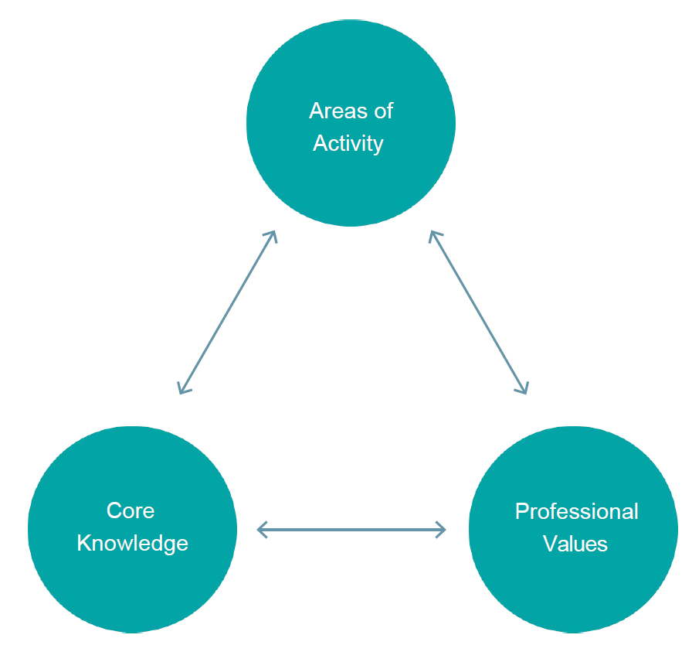
Why? Professional Values and the UKPSF
Reflecting the values that drive our passion for our subjects
  Wider sustainability values: see Earth Charter
Professional recognition through HEA Fellowship and the UK Professional Standards Framework
V4: “Acknowledge the wider context in which higher education operates recognising the implications for professional practice”

Slide 7
2: How?
[Use chat window to note specific questions you have]

Slide 8




Education for Sustainable Development
Holistic learning (Head, Heart and Hands) for the common good
Understanding Sustainability:
What is ‘(un)sustainable’, society’s challenges, possible solutions, linked to discipline…
Transformational Experiences: Inspiration, indignation, collective action, achievement…
Competencies to Act:
Motivation, self-confidence, values, big-picture thinking, group-working skills…
Taking Action:
Volunteering, projects, placements, making a difference…

Slide 9
At Programme Level
Key issues to consider:
Learning Outcomes: Engagement with sustainability or the SDGs reflected in one or more assessments in core modules
Pedagogy: Experiential learning activities addressing real-world problems on campus or in wider community
Co-curricular links: Linkages to community events, trips, volunteering, student societies (e.g. ‘Enactus’, ‘Map the System’)
Support available on https://esdg.our.dmu.ac.uk – case studies, introduction to ESD guidance (e.g. QAA/HEA) and one-page planning toolkits (e.g. “Ten Ingredients”)

Slide 10
DMU Examples
School of Fashion and Textiles (Carolyn Hardaker)
Engineering Programmes (John Gow)
Leicester Castle Business School (Steven Baguley)

Slide 11

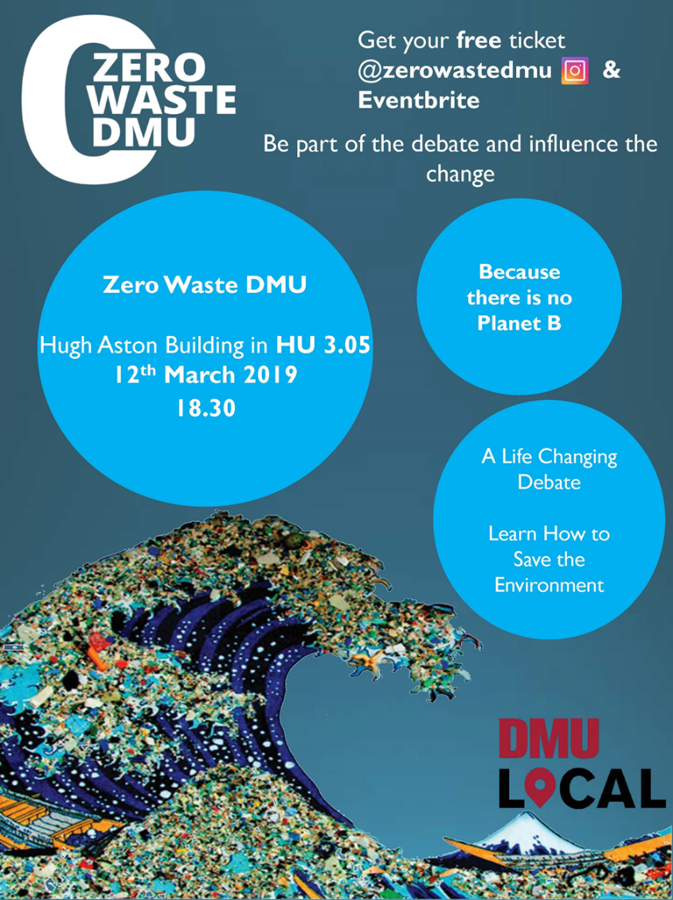
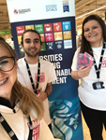
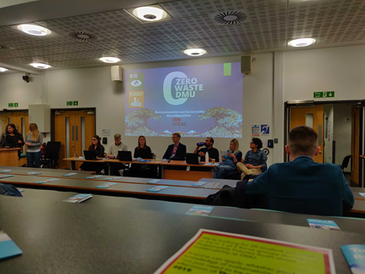
Example: Service Learning
Politics in Action: 2nd year, 15-credit, year long in Politics programmes. Approx. 80-90 students in 3 groups
  Contact: Ros Lishman
Activity: projects addressing SDGs, linked to DMU Local
Assessment: Reflection in range of possible formats

Slide 12
Example: Service Learning
Politics in Action ESD Outcomes:
Knowledge: many students had little/no awareness and understanding before module; developed critical engagement and reflection; feeds into other modules and engagement activities; 100% (n=40) of students in wk 21 (2018/19) confirmed module had contributed to their understanding and knowledge of UN SDGs
Competencies: organisation of the module enables students to develop collaborative thinking and working – linked to employability/graduate skills (QAA Politics & IR Subject Benchmark); gained volunteering hours
Transformative learning: many examples where involvement in module and projects has changed behaviour and commitment to sustainability
Taking action: focus of the module is to raise awareness of relevance and application of UN SDGs at a local level and to facilitate local action; emphasis on practice (rather than theory – which the students appreciate); students proud of achievements

Slide 13
Example: Module Design Process
‘Influences on Wellbeing’ – new level 4 module in School of Nursing and Midwifery (from 2022)
  Contact: Penny Tremayne
Process
  Half-day session with course team, CELT and ESD project, focus on learning outcomes and assessment
  Follow-up meetings/email to integrate sustainability
Outcome
  ‘Sustainable Integrated Care’ as core concept in module, linking sustainability competencies with subject-specific skills
  Plans for specific sessions to introduce core concepts

Slide 14

Support and Resources
About Sustainability and ESD
  https://esdg.our.dmu.ac.uk/about/introducing-esdg/
DMU Case Studies
  https://esdg.our.dmu.ac.uk/staff/case-studies/
One-page planning toolkits
  https://esdg.our.dmu.ac.uk/staff/planning-toolkits/

Slide 15
Accessible Next Steps
Upcoming workshops
  ESD Drop-in Mondays 1pm to 2pm in July
  Intro to ESD, July 23rd (book on DMUHub, My Development)
‘Ten Ingredients’ tool can be used to plan for 2020/21
  Identify strengths, small-scale changes, long-term aspirations
  ESD Team can go through this with you
Take part in the SDG Teach-in
  22nd to 26th February 2021
  Make a link to the Sustainable Development Goals in a taught session that week

Slide 16
Get Actively Involved
Follow @SustainableDMU on social media
Join ESD Forum
  Quarterly meetings and email list
  Email Andrew Reeves areeves@dmu.ac.uk

Slide 17
Q&A and Discussion
ESD Project Coordinator:
Andrew Reeves
areeves@dmu.ac.uk
ESD Academic Development Lead: Ian Coleman ian.coleman@dmu.ac.uk

