Slide 1
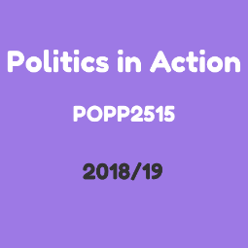
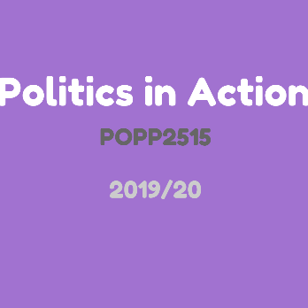
POPP2515: Politics in Action
Module: 15 credit, year long, compulsory/optional for UG f/t politics /IR and joints
Students: approx. 80-90
Groups: 3 workshops decided by timetabling (approx. 20-30 students in each)
Teams/projects: consultation with course reps - preference for self-selecting teams with self-selecting team leader, 1 or 2 projects per workshop
Staffing: Module leader, Mentor, guest lecturers, DMU Local
Timetable: Term 1: weekly 2 hour workshops; Term 2: fortnightly 2 hour workshops; Fortnightly self-directed learning – 1 hour.
SRO
Module Leader
Student
Project leaders
Student
Project leaders
Student
Project leader
#DMU Local
PPP Mentor
Thurs Project (1)
Weds Projects (2)
Tues Projects (2)

Slide 2

DMU Local
Presentation to students about DMU Local
Attended project pitching week
Allocated budget for projects
Supplied marketing materials
Raised awareness about volunteering opportunities
Provided expertise in reviewing project proposals and progress

Slide 3
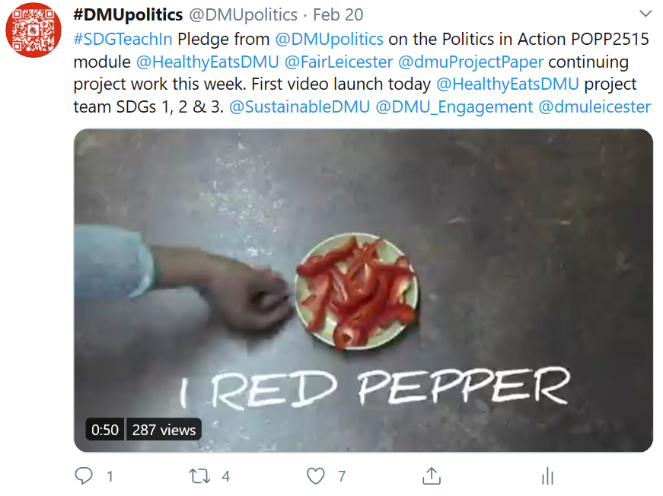
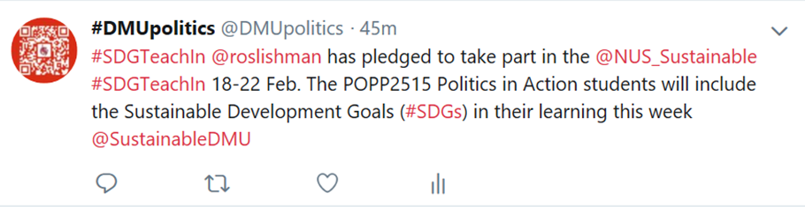
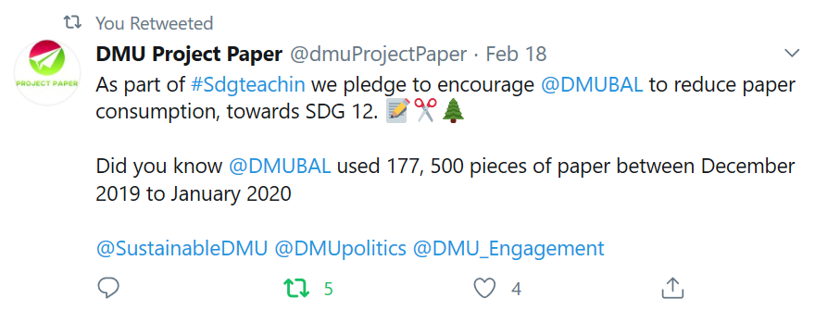
UN SDGs: workshop activities 2019/20
Week 1: questionnaire to students included question about UN SDGs
Week 3: critical discussion and activities on UN SDGs
Weeks 5-8: groups of approx. 5 students scoped an idea for a local project based on UN SDGs
Week 9: students presented outline project proposal and voted on preferred project(s); gained greater awareness of local relevance of UN SDGs
Week 21: NUS Teach-In: pledge and review of knowledge/understanding on UN SDGs gained on module
Reflective activities also in weeks 15, 23, 25

Slide 4
Module assessment
Personal reflection
Students choose 1 assignment type
100% of module mark
Deadline: end of term 2
Need to submit some text / references to Turnitin - all types
Multimedia files submitted to Turnitin or DMUReplay
Assessment Criteria
Local politics in action (20%):
engagement with the concept of politics in action and the application of the UN SDGs at a local level
Skills development (50%)
Communication (20%)
Academic skills (10%)
Written ‘digital’ report/essay
2,500 words
Recorded Presentation
8 slides/15 mins voiceover
Podcast & script
15 mins
Video & script
15 mins
Poster
A1

Slide 5
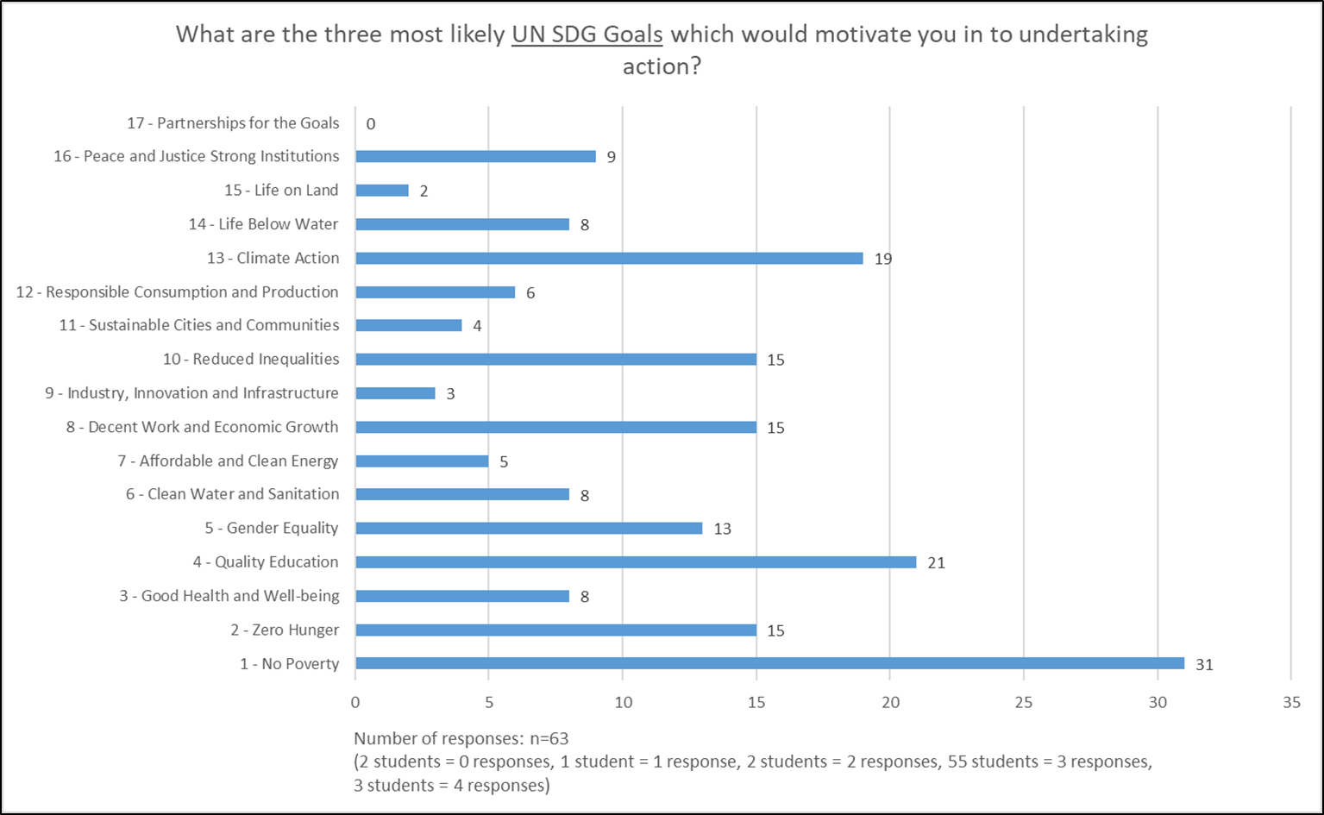
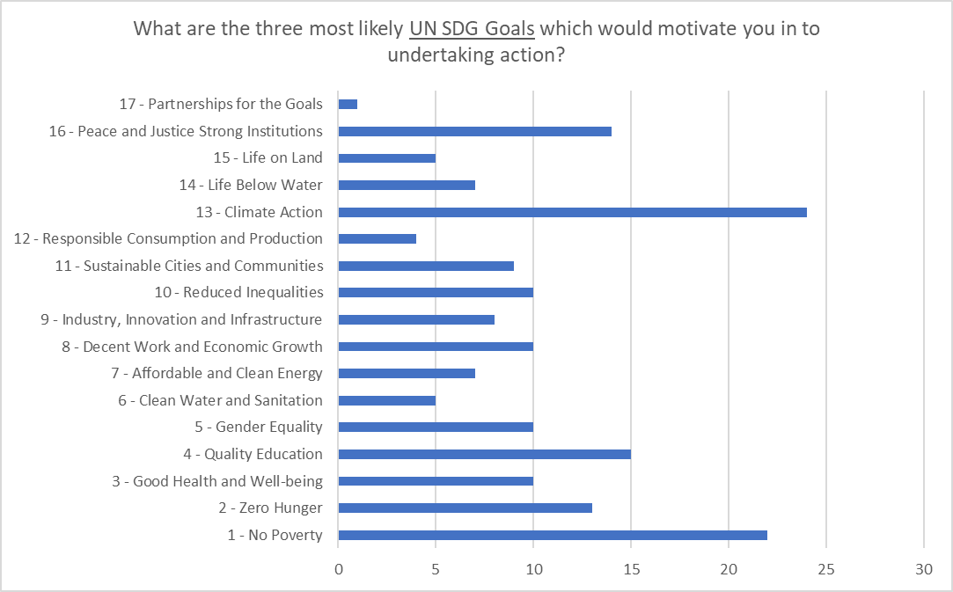
UN SDGs: areas of interest & motivation
Action and politics
activism
belonging to a political party
community development
community engagement
direct action
individual and collective action
influencing policy and politics to transform public decision-making
large-scale campaign advocacy
legal rights education
local and global action
neighbourhood organising
online campaigns
political lobbying
public engagement
2018/19
Data source: Week 1 Questionnaire to students
2019/20

Slide 6
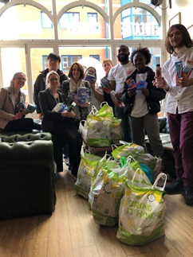
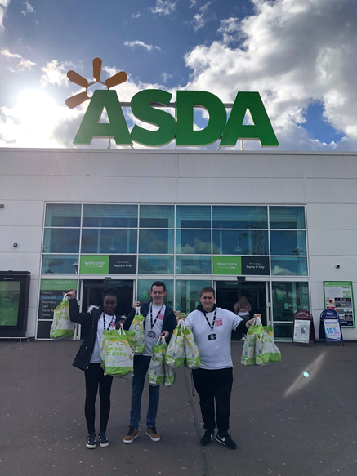

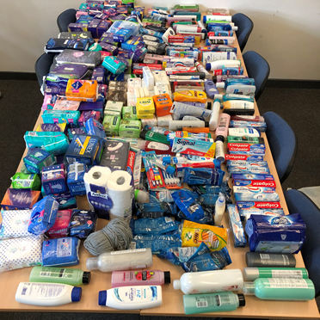
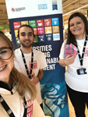
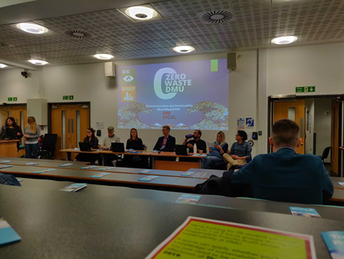
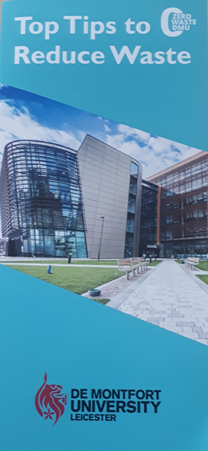

Projects: 2018/19
Zero Waste
Raising awareness about waste reduction
Poster, leaflet, video, debate event, social media
Access to Hygiene
Raising awareness, collecting and distributing personal hygiene donations
Leaflet, poster, collection box, collection days (Asda), donation drop off
Plates for Playoff
Fundraising event, buying food donations, volunteering at foodbank
Poster, connection with DMUSport, volunteering at foodbank
SDGs 12 & 14
SGDs 3 & 6
SDGs 2 & 3
https://twitter.com/zerowastedmu
https://www.instagram.com/zerowastedmu/
https://www.youtube.com/watch?v=ugjVlFsj8hE&feature=youtu.be
https://twitter.com/accesstohygiene
https://www.instagram.com/accesstohygiene/
https://www.facebook.com/Accesstohygiene/

Slide 7
Knowledge, skills & experience gained on the projects by students: 2018/19
Zero Waste | Access to Hygiene | Plates for Playoff
Creating leaflets and posters Engaging with local Friends of the Earth group Gaining knowledge about waste reduction Gaining volunteering hours Making a video Managing social media Marketing and communications Planning & organising an event Raising awareness about reducing waste Working in teams Working with #DMUlocal Working with/as project leaders Working with DMU staff Working with local businesses | Collecting and distributing donations Creating a DSU society Creating leaflets and posters Gaining knowledge about hygiene and homelessness Gaining volunteering hours Managing social media Raising awareness about period poverty Working in teams Working with #DMUlocal Working with/as project leader Working with DSU Working with The Y/Dawn Project | Creating a poster Gaining awareness about food poverty Gaining knowledge about food banks Gaining volunteering hours Managing social media Organising a rota Planning an event Raising awareness about food banks Working in teams Working with #DMUlocal Working with/as project leaders Working with DMU Sports Working with Manor House

Slide 8
Projects: 2019/20
Healthy Eats
https://www.instagram.com/healthy.eats.dmu/ https://twitter.com/HealthyEatsDMU
Project Paper
https://twitter.com/dmuProjectPaper
Fair Leicester
https://www.instagram.com/fair.leicester/
HungerWaste
Let’s Eat
Reflections & lessons:
Project failure
Project planning
Leadership
Gains:
Friendships & confidence
Skills & knowledge
Topic insights

Slide 9
Politics in Action: ESD outcomes
Knowledge: many students had little/no awareness and understanding before module; developed critical engagement and reflection; feeds into other modules and engagement activities; 100% (n=40) of students in wk 21 (2018/19) confirmed module had contributed to their understanding and knowledge of UN SDGs
Competencies: organisation of the module enables students to develop collaborative thinking and working – linked to employability/graduate skills (QAA Politics & IR Subject Benchmark); gained volunteering hours
Transformative learning: many examples where involvement in module and projects has changed behaviour and commitment to sustainability
Taking action: focus of the module is to raise awareness of relevance and application of UN SDGs at a local level and to facilitate local action; emphasis on practice (rather than theory – which the students appreciate); students proud of achievements

Slide 10
Planning for 2020/21
Off campus-ish
Small supervision teams (approx. 10 students)
‘Ready made’ projects
Project management specialist
LSP©: earlier & separate from careers
Community week (week 22) focus of activity

Slide 11
More information
Ros Lishman
Department of Politics, People & Place
Associate Professor & DMU Teacher Fellow
BSc (Hons), PgDip, SFHEA
rlishman@dmu.ac.uk
0116 257 7434

