Slide 1

DMU’s SOS Skills Survey Data
2016 -2024
By the DMU Sustainability team

Slide 2
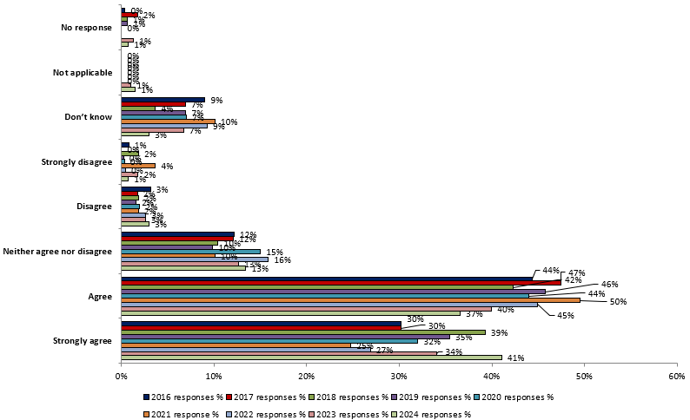
My university / college takes action to limit negative effect it has on people and the environment

Slide 3
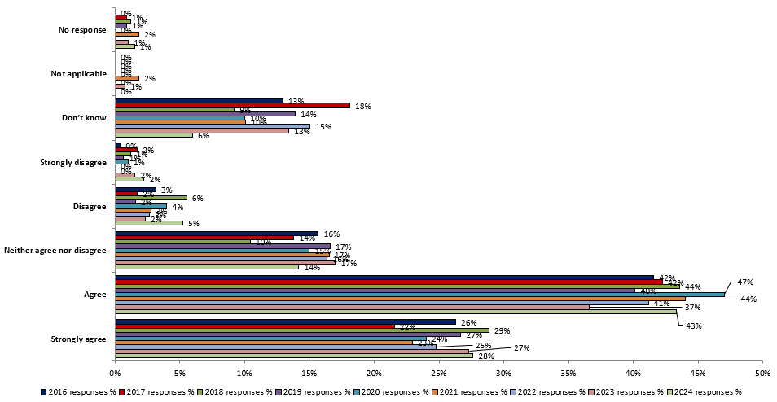
My students' union takes action to limit negative effect it has on people and the environment

Slide 4
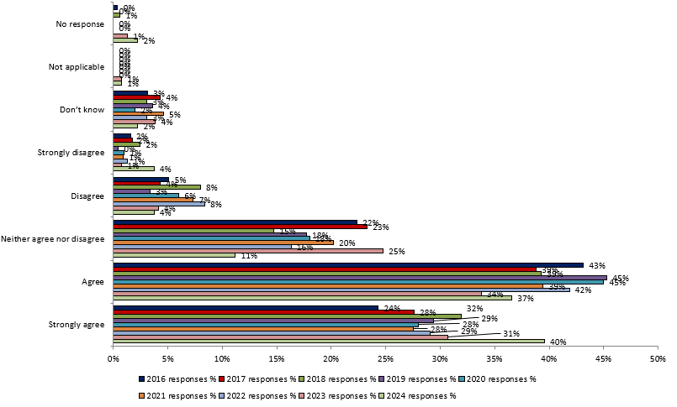
Being a student at my university / college encourages me to think and act to help the environment, and other people

Slide 5
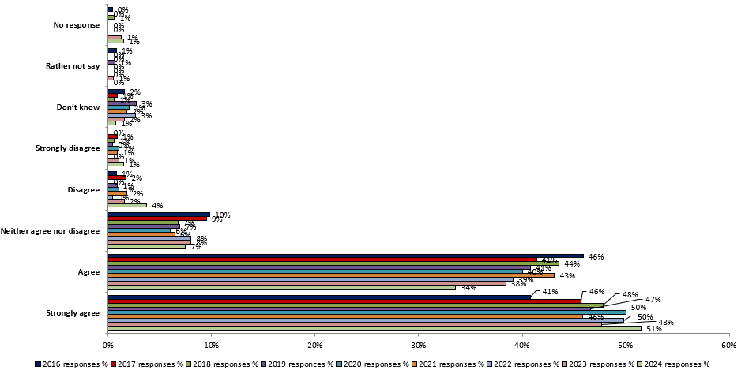
Sustainable development is something which universities / college should actively incorporate and promote

Slide 6
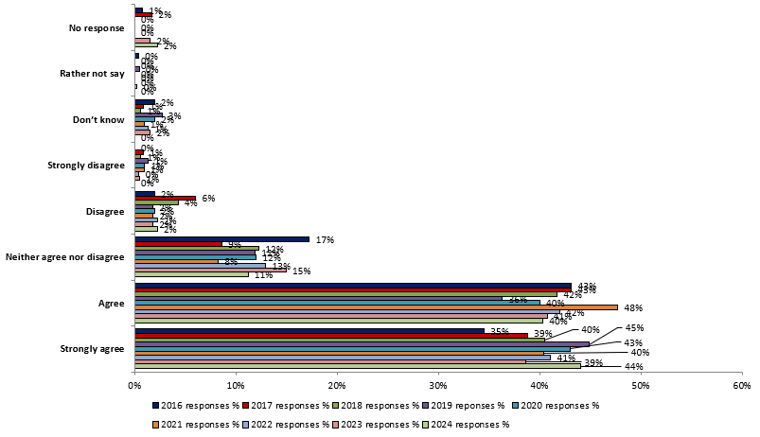
Sustainable development is something which all university / college courses should actively incorporate and promote

Slide 7
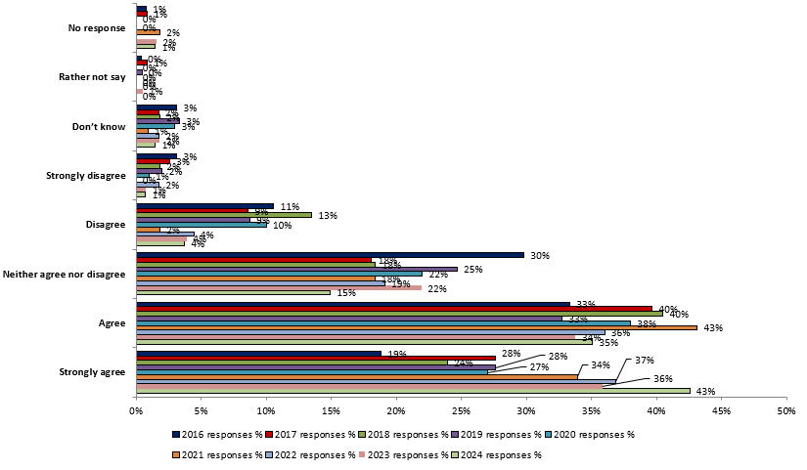
Sustainable development is something all course tutors should be required to incorporate within their teaching

Slide 8
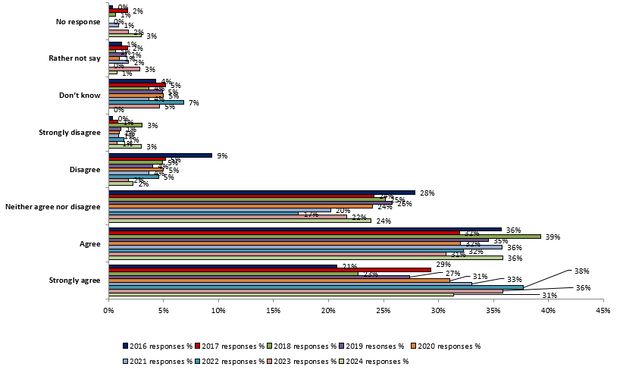
Sustainable development is something which I would like to know more about

Slide 9
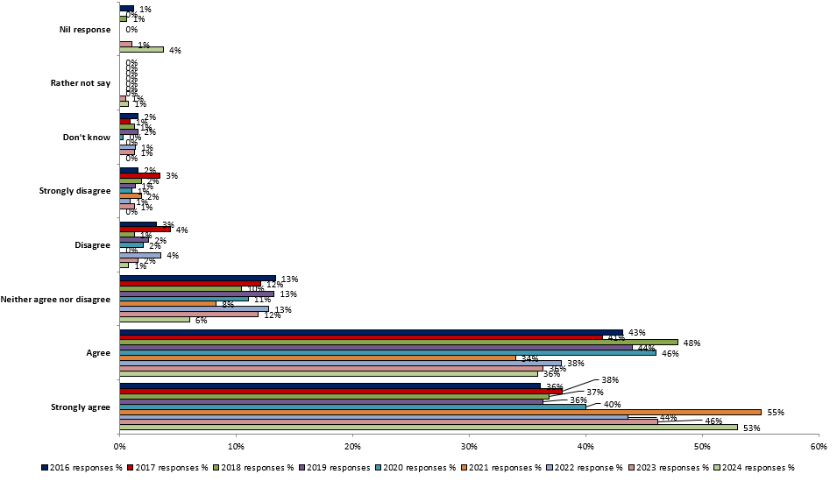
To what extent, if any, do you agree that universities / colleges should be obliged to develop student's social and environmental skills as part of their course?

Slide 10
We’d also like to hear more about your experiences of learning linked to colonialism. To what extent do you agree or disagree with the following statement:
“Through my time my place of study so far, I’ve learnt…”

Slide 11
Thinking of your time at your current place of study, which of the following issues been covered in the teaching so far?

Slide 12
How important do you think it is for your future employers that the people they hire have these skills and understanding?

